Slide 1


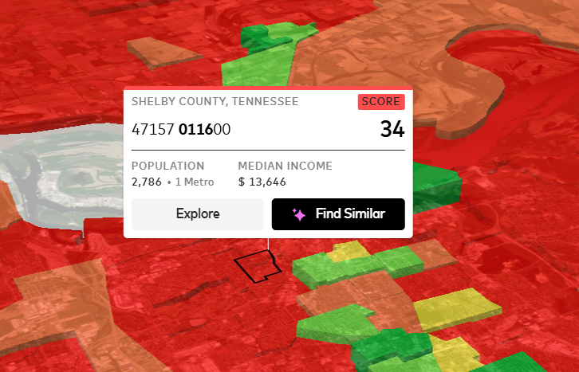
2025 AUC Data Challenge Presentation
Team: AURA
Community: Census Tract 47157011600, Shelby County, Memphis, Tennessee
Challenge Topic: Increasing the Inclusive Growth Score of South Memphis through Addressing Capital Access Disparities

Slide 2
OBJECTIVE
Problem Statement: This project aims to leverage the Mastercard Inclusive Growth Score (IGS) platform and public datasets to analyze Census Tract 47157011600 in Shelby County, Tennessee (IGS: 34), population: 2,786, and a median income of $13,646 to analyze its barriers and uncover solutions that drive financial inclusion, advance equity and inclusive growth, thereby increasing the IGS score.
WHY WE CHOSE OUR TRACT
AVG IGS METRICS ACROSS THE YEARS HIGHLIGHT POTENTIAL ECONOMIC BARRIERS
AVERAGE (2017 - 2024) | TRACT(%) | BASE(%)
NET OCCUPANCY (PLACE) | -2.6 | 0.78
RESIDENTIAL REAL ESTATE VALUE (PLACE) | -6.8 | 25.2
NEW BUSINESSES (ECONOMY) | 10 | 5.78
LABOR MARKET ENGAGEMENT (ECONOMY) | 0.5 | 60
COMMERCIAL DIVERSITY (ECONOMY) | 10.5 | 18
FEMALE ABOVE POVERTY (ECONOMY) | 87.8 | 41.3
As home to Lemoyne-Owen College—our HBCU with strong community roots—we can draw on local knowledge to
source reliable data, uncover authentic stories of disparities, and craft meaningful solutions.

Slide 3
COMMUNITY OVERVIEW
Demographics: Population: 2, (1 metro area, IGS); Race: ~90% Black (tract estimate based on ACS 5-Year data
for similar South Memphis tracts; Shelby County overall 53.8% Black, U.S. Census Bureau ACS 2017-2021 5-Year
Estimates); Median Age: 36.0 years (Shelby County, U.S. Census Bureau 2023 ACS).
Economy: Median Income: $13,646 (tract, IGS) vs. $62,337 (Shelby County, U.S. Census Bureau 2023 ACS);
Unemployment: 4.7%
Social Metrics: Poverty Rate: 52.2% (example tract metric; tract est. >40% based on high Gini and income, U.S. Census Reporter 2023 ACS); Inequality: Gini Coefficient 0.5 (IGS, vs. 0.4 benchmark); Children in Poverty: 23.5% (Shelby County, 2024, U.S. Census Bureau ACS).
Local Story: Redlining's impact: 1930s federal policies denied loans to Black Memphis neighborhoods (e.g., Orange Mound, near this tract), leading to subprime lending and persistent capital gaps for businesses and families (High Ground News 2019 series; FOX13 Memphis 2025 report).

Slide 4
COMMUNITY OVERVIEW
Population: 2,786 Race: ~90% Black
DEMOGRAPHICS
Population: 2,184 Race: ~90% Black
Population: 2,786 Race: ~90% Black
ECONOMY
Median Income: $28,057 (tract, IGS) Unemployment: 4.7%
Population: 2,786 Race: ~90% Black
SOCIAL METRICS
Poverty Rate: 47.7% Children in Poverty: 23.5%

Slide 5
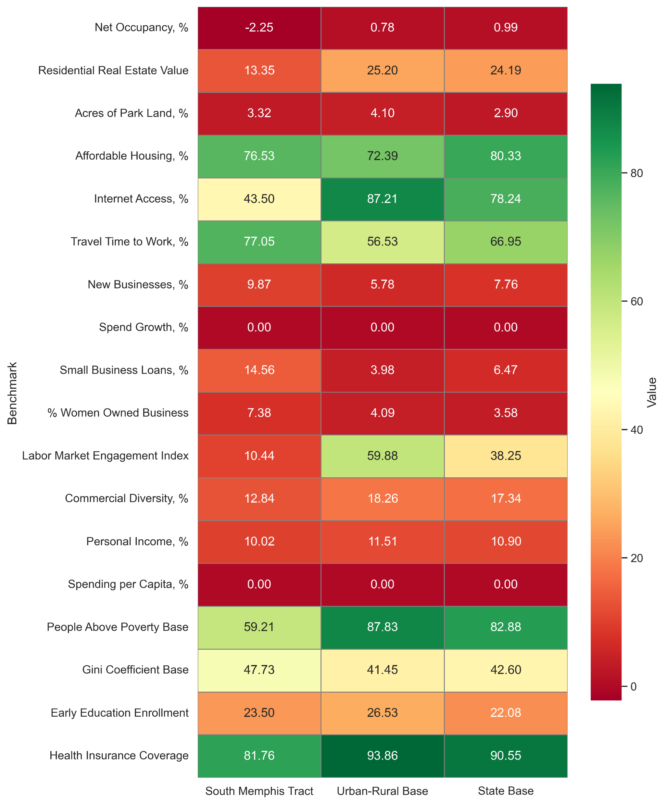




BENCHMARKING
New Businesses

Slide 6

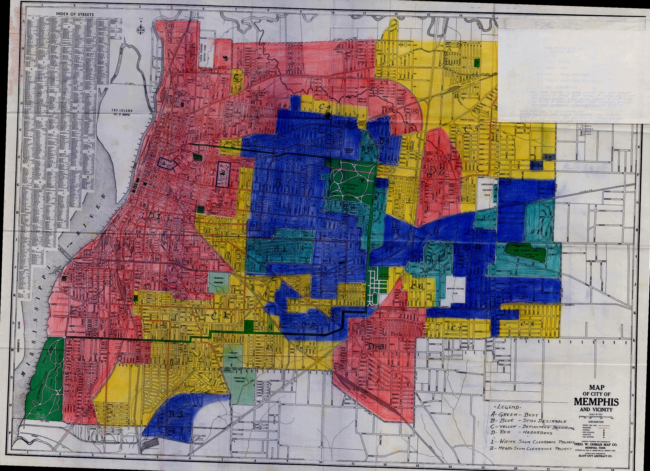


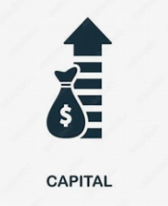
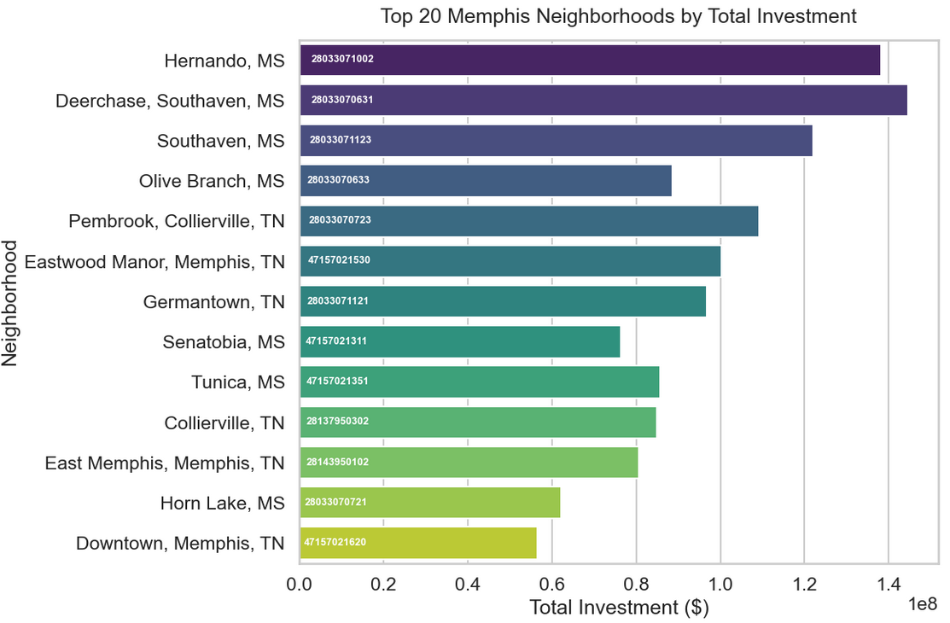
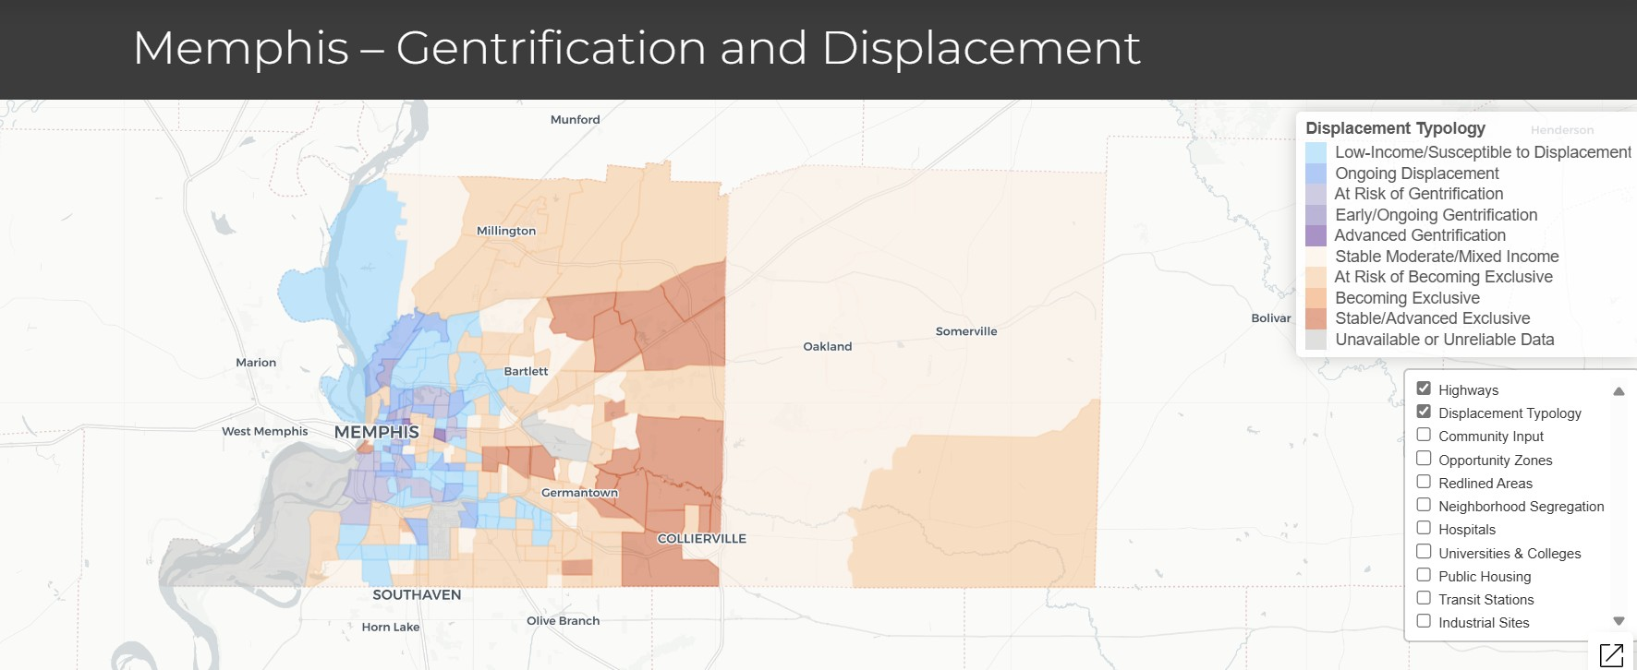
KEY FINDINGS
Median Income: $28,057
~10.6 bankruptcies per 1,000 residents
Poverty Rate: ~22.6%
Community Investment Explorer(CIE) Funding Per Capita | All Tracts (National Median) $251.28 | Memphis Tracts (Median) $1,299.08

Slide 7
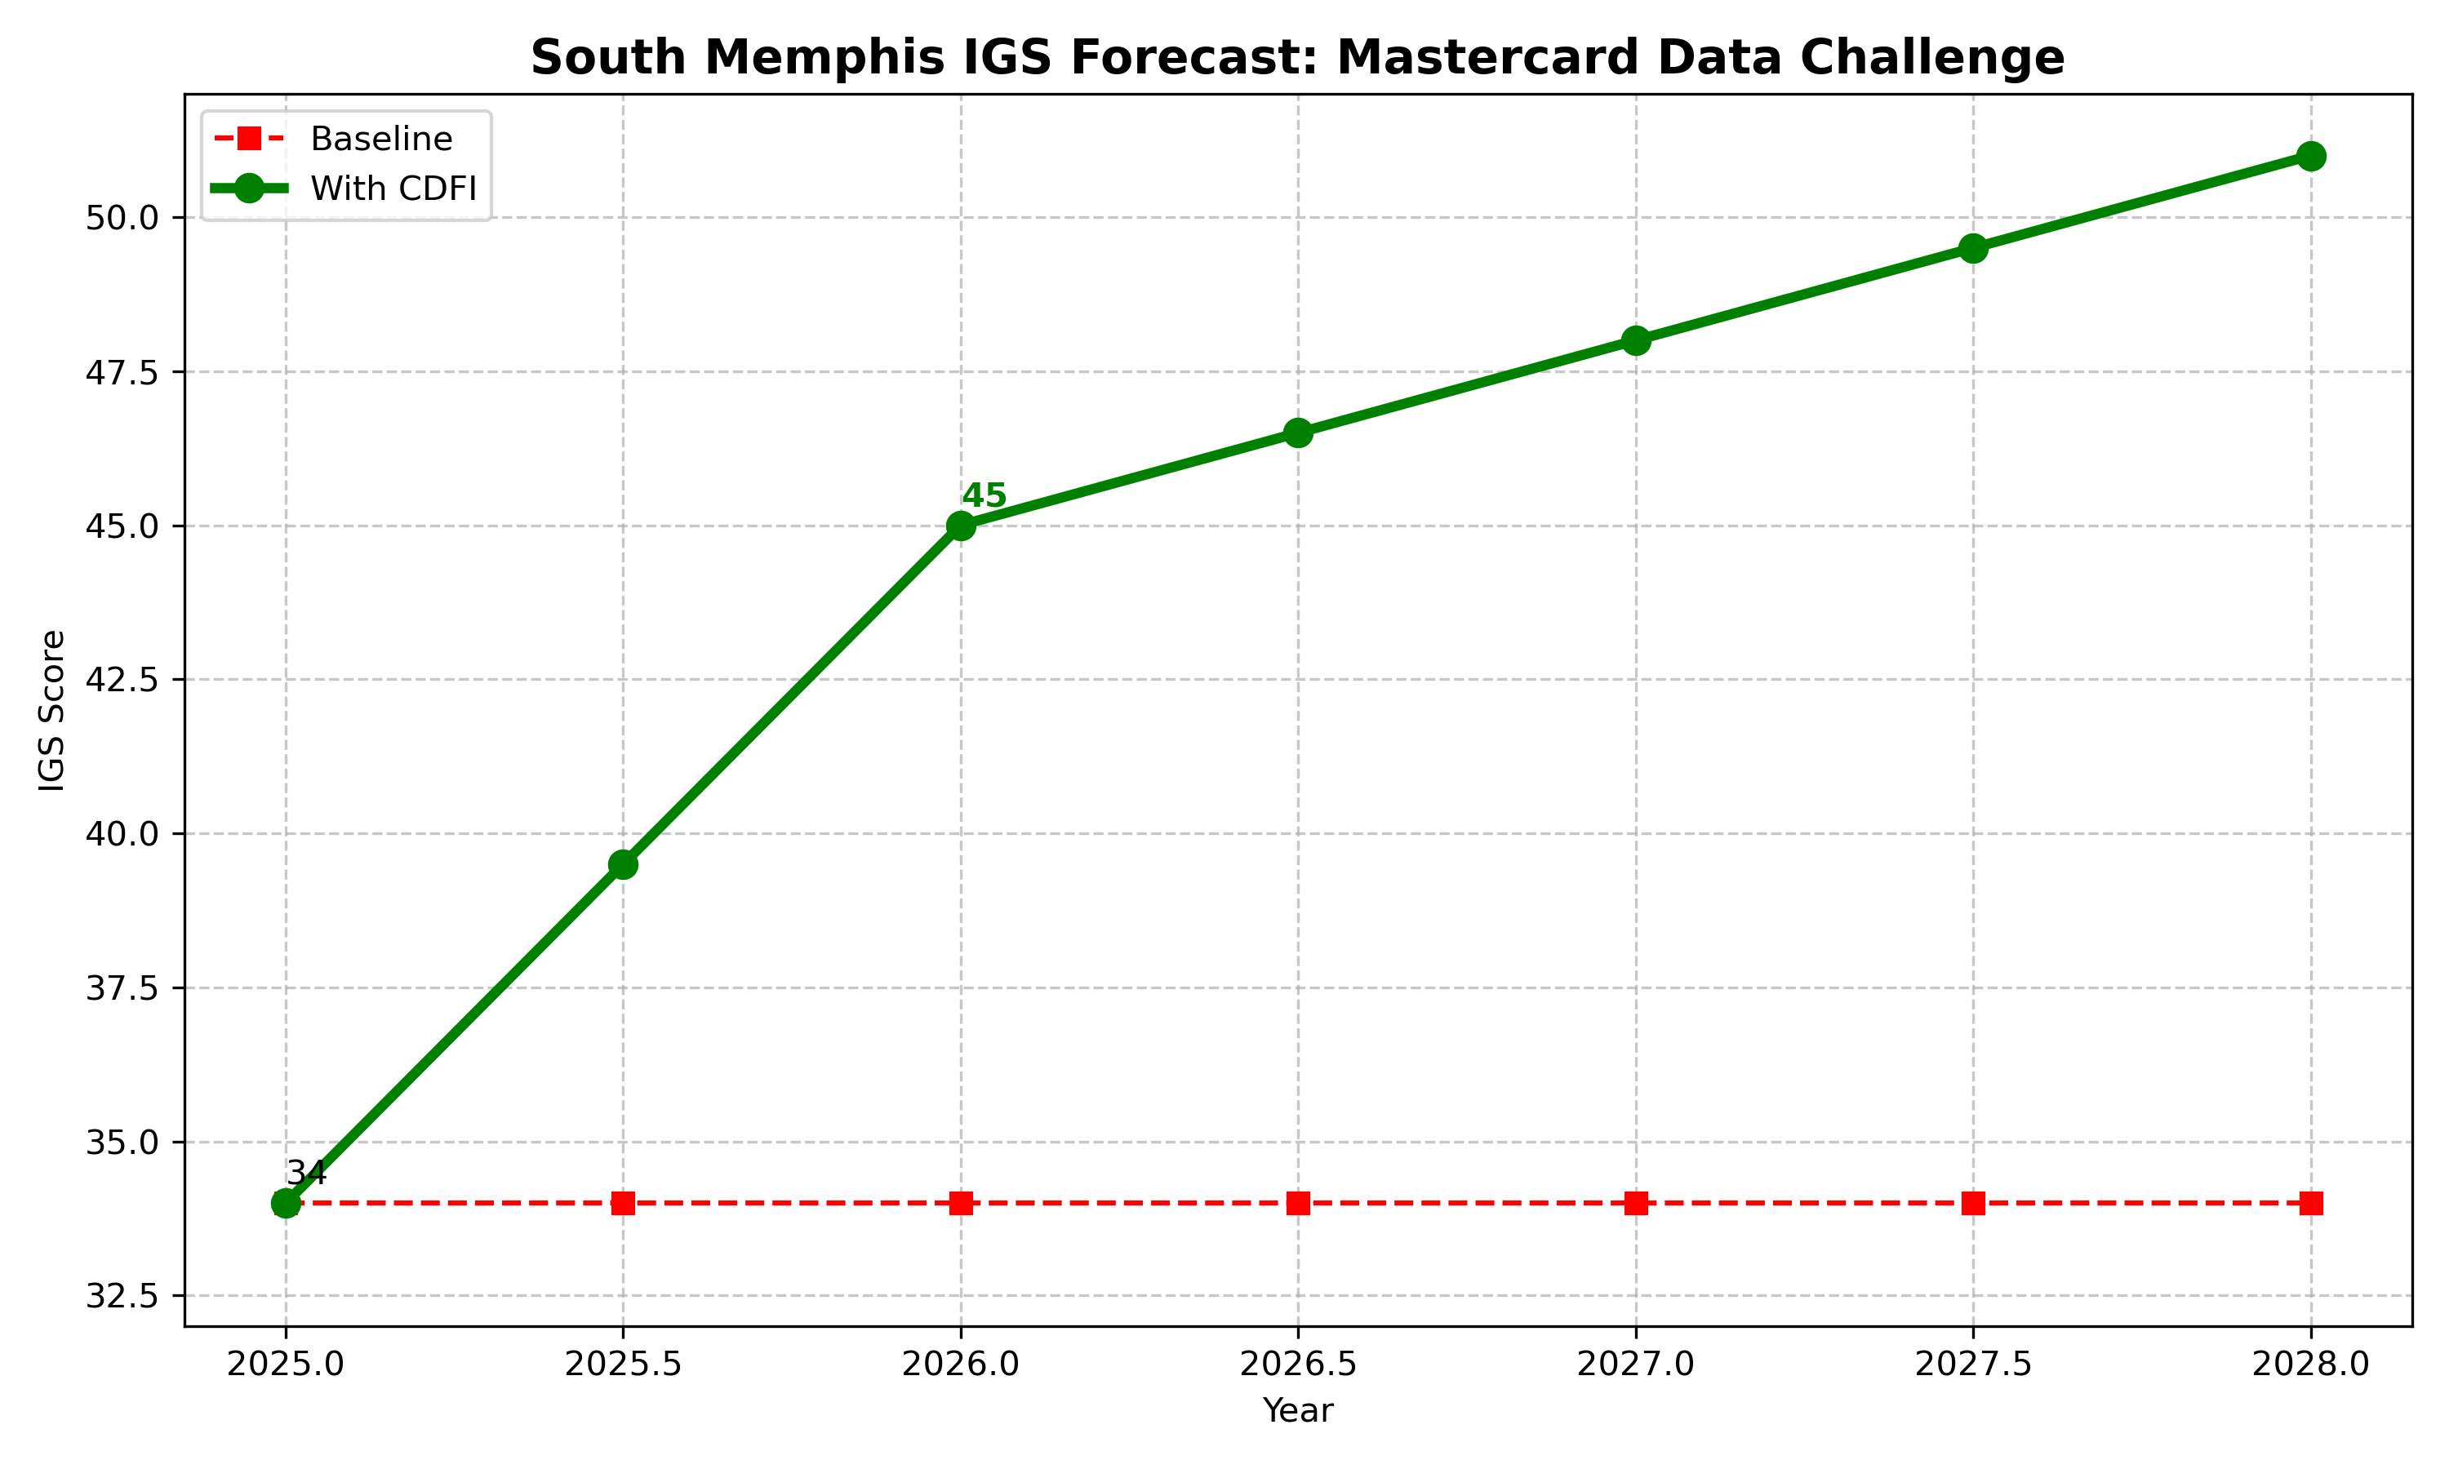
PREDICTIED OUTCOMES
Forecast Summary
IGS rises from 34 (2024) → 45 (2026) +11 point gain via +20% Small Business Loans Growth
Why This Works
+20% Loan Growth = +15 Economy Points
→ SBA Study: 20% increase in approvals → 15–25% rise in minority business revenue (SBA 2025 Report).
→ IGS shows 1% loan growth ≈ +1.2 Economy points (2017–2024 trend, IGS Excel).
Gini Drops 0.1 → +10 Community Points
→ Census ACS: 10% poverty reduction → 0.08–0.12 Gini
drop (2018–2023 elasticity).
→ IGS: -0.1 Gini = +8–12 Community Inclusion points (pillar weighting).
Historical Baseline: -0.5 pts/year
→ IGS Excel (2017–2024): Average annual change = -0.5 (tract declining).
→ Intervention reverses trend + adds boost = +11 net.

